Slide 1
Spirituality & Servant- Leadership
By Kara Keating
Gonzaga University

Slide 2
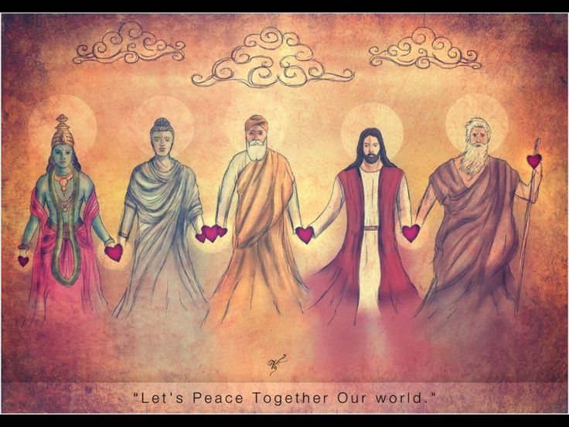
Servant First Leadership
“The servant-leader is servant first…. It begins with the natural feeling that one wants to serve, to serve first. Then conscious choice brings one to aspire to lead” (Greenleaf, 1977, p. 27).
“As a framework for leadership development, servant-leadership is focused on the development of the person and the organization for the purpose of creating a more serving caring society” (Horsman, 2015, p. 12).
“What separates servant-leadership from other discussion of leadership is that fundamentally it concerns servants who lead, not leaders who serve” (Horsman, 2015, p. 14).

Slide 3
What is Servant-Leadership?
Values people and believes in them by valuing them before themselves and deeply listening
Develops people through learning, growth, and encouragement
Builds community by strong relationships by working with others and valuing relationships
Displays authenticity by being open, accountable, willing to learn, and maintaining integrity
Provides leadership by vision, initiative, and clear goals
Shares leadership by creating a shared vision, sharing power, releasing control, and promoting others (Horsman, 2015, p. 15)

Slide 4
Servant-Leadership and Human Development
Hall’s Three Phases
Key Skills Developed
Phase I is about survival and limited sense of self beyond it
Phase II is about succeeding in groups and developing skills to work with others
Phase III is about developing an independent sense of ourselves and honoring our own judgement (Horsman, 2015, p. 7)
Instrumental Skills – Skills of the mind and hands
Interpersonal Skills –Understanding others
Imaginal Skills – Creative thinking and vision
System Skills – Understanding the complex systems (Horsman, 2015, p14)

Slide 5
Self-Reflection Questions
Who have you seen model servant-leadership? What was it like to work with them?
What are some of your reasons for wanting to put people first?
Which of the 4 leadership skills are you working on developing? Where do you need to grow in this area?
What does a more caring society look like for you? How can you create that in your organization?
What does it look like for you to develop people and grow them? How can you improve in this area?

Slide 6
Combines Heart, Mind, & Spirit
Definitions
Applying Them
Heart: regarded as the seat of emotions, personality, attributes.
Mind: the thinking and perceiving part of consciousness.
Spirit: a pervading animating principle, essential, or characteristic quality of life (Spears, 2015).
Heart – Caring about and for others. Seeking to serve others
Mind – Applying creativity and education to find solutions that work for those we serve and the organizations we work with.
Spirit – Connecting to the inner source of wisdom and knowledge. Finding balance between work and self.

Slide 7
Servant Heal Thyself First
Servant-Leadership Meditation
May you be free of pain and suffering.
May you be happy.
May you love and be loved.
May you find the healing that you seek.
May you find peace (Spears, 2015).

Slide 8
Aligning Words and Actions
“At the highest level of skill attainment you can teach by demonstrating – being – the change you (and possibly others) desire to experience in themselves and in the world around them. This does not require you to be perfect, because nobody is perfect; it means that you have integrity and you are consistent. What you teach others by words and how you behave (deeds) are the same. You walk your talk. You are peaceful, compassionate, and wise in times of stress, and your behavior during these times allows you to become a role model for others (Wigglesworth, 2012, p. 105).

Slide 9
Self-Reflection Questions
Is your heart, mind, and spirit aligned in how you are leading now? What areas need to grow?
How did it feel to wish the end of suffering for others? Were there people that were difficult to envision happiness? How can you heal this challenge?
How did you feel after you let people go and let your own suffering go?
Are you aligned with your words and your actions? Where are you good at this and where do you need some improvement?
Are you aligned with your spirit? Are you doing things that do not feel right for you? What are they? How can you align them?

Slide 10
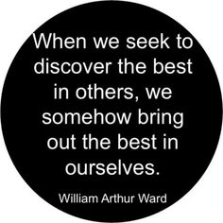
Building a Good Society
A Spiritual Leader’s Role
“A religious leader simply makes his or her best effort to build and sustain a good society. The result will be whatever it is. It is not within the power of any of us mortals to determine the outcome (fortunately). A ’good’ society is seen as one in which there is widespread faith as trust … that encourages and sustains ordinary, good people as constructive influences in the world” (Greenleaf R. K., 1998, p. 115).

Slide 11
Spirituality as a Life Orientation
“Spirituality is concerned with the relationship between the human spirit and the Universal Spirit – between the human being and God…. Spirituality is the orientation of one’s life toward God – not away from others and not even away from the legitimate needs of the self, but toward God” (Thompson, 2000, p. 55).
4 Essential Prerequisites
Open to the influence of a higher power
Acknowledge that power as our source of meaning and value
Align ourselves with that power and its purpose for us
Cultivating the presences of that higher power (Thompson, 2000, pp. 56-58).

Slide 12
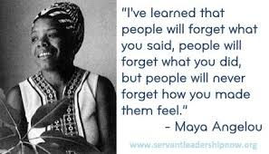
Leading is Giving
“Leading is giving. It is an ethic, a gift of oneself to the common cause…. The essence of leadership is not giving tangible things or even inspirational visions. It is offering oneself and one’s spirit”
(Bolman & Deal, 2011, p. 122).

Slide 13
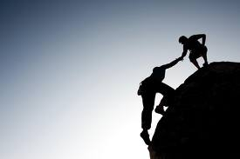
Leading is Love
“ The people who help us grown toward true self offer unconditional love, neither judging us to be deficient nor trying to force us to change but accepting us exactly as we are. And yet this unconditional love does not lead us to rest on our laurels. Instead, it surrounds us with a charging force field that makes us want to grow from the inside out – a force field that is safe enough to take the risks and endure the failures that growth requires” (Palmer, 2004, p. 60).

Slide 14
Self-Reflection Questions
In what ways are you building a good society? How are you encouraging and sustaining ordinary people to care for the world?
Are you open to the influence of a higher power?
Do you doubt the guidance you receive or have difficulty acting on the guidance from that higher power? How can you heal that doubt?
In what ways are you cultivating presence in your life?
In what ways can you love others more?
In what ways can you be more accepting of others and their differences?

Slide 15
Taking God’s Hand
Patient Trust by Pierre Teilhard de Chardin, SJ
Above all, trust in the slow work of God. We are quite naturally impatient in everything to reach the end without delay. We should like to skip the intermediate stages. We are impatient of being on the way to something unknown, something new. And yet it is the law of all progress that it is made by passing through some stages of instability— and that it may take a very long time.
And so I think it is with you; your ideas mature gradually— let them grow, let them shape themselves, without undue haste. Don’t try to force them on, as though you could be today what time (that is to say, grace and circumstances acting on your own good will) will make of you tomorrow.
Only God could say what this new spirit gradually forming within you will be. Give Our Lord the benefit of believing that his hand is leading you, and accept the anxiety of feeling yourself in suspense and incomplete.

Slide 16
References
Bolman, L. G., & Deal, E. T. (2011). Leading with Soul. San Francisco: Jossey-Bass.
Greenleaf, R. K. (1977). Servant Leadership: A Journey into the Nature of Legitimate Power & Greatness. Mahwah: Paulist Press.
Greenleaf, R. K. (1998). The Power of Servant Leadership. San Francisco: Berrett-Koehler Publishers, Inc.
Horsman, D. J. (2015, 02 20). Blackboard Learn. Retrieved from Gonzaga University: https://learn.gonzaga.edu/webapps/portal/frameset.jsp
Palmer, P. J. (2004). A Hidden Wholeness: A Journey Toward an Undivided Life. San Franscisco: John Wiley & Sons.
Spears, D. L. (2015, 10 22). Blackboard Learn. Retrieved from Gonzaga University: https://learn.gonzaga.edu/webapps/portal/frameset.jsp
Thompson, C. M. (2000). The Congruent Life. San Francisco: Jossey-Bass.
Wigglesworth, C. (2012). SQ 21: The Twenty-One Skills of Spiritual Intelligence. In C. Wigglesworth, SQ 21: The Twenty-One Skills of Spiritual Intelligence. New York: Select Books Inc.

